Slide 1
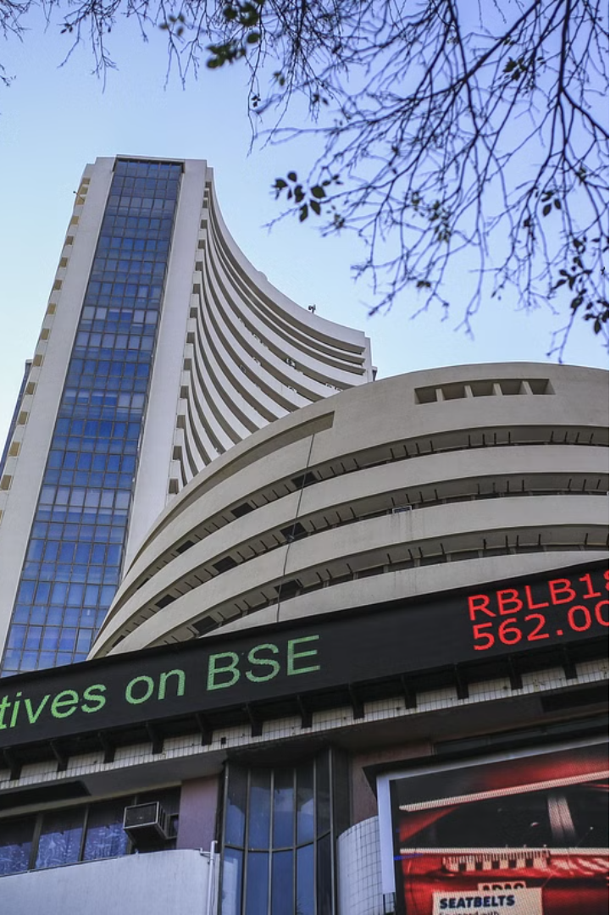

Enhanced Value and Momentum Index
The Enhanced Value and Momentum Index is a unique investment strategy that aims to capitalize on the long-term outperformance of value and momentum investing in the Indian stock market. By leveraging the historical data on the Nifty 50, Midcap 150, and Smallcap 250 indices, this index seeks to deliver superior returns while managing risk through a dynamic asset allocation approach.
by team Alpha

Slide 2
Team Alpha
Dilip Kumar Mohapatro
Vivek Bhattacharya
Sheetal Varshney

Slide 3
Why index investment?
Cash is loosing its value over time, due to inflation
Due to cyclical nature of business and questionable long term probability of sustainability of growth of a kind of business led us to invest in bucket of top-N companies i.e. indexes in stead of choosing single/few focused companies for long term investment.
As per Warren Buffett’s value investing principle, not only buy index when cheaper but also capture the momentum by buying fastest growing indices to profit from bull run and also hedge the portfolio by investing in gold and money market during worst fall of market to protect the capital.

Slide 4
Indices Considered
Nifty 50
Midcap 150
Smallcap 250
The Nifty 50 index, representing the 50 largest and most liquid Indian companies, has historically delivered a CAGR of around 12% over the last 30 years.
The Midcap 150 index, comprising the next 150 largest companies after the Nifty 50, has generated a CAGR of approximately 20% over the same period.
The Smallcap 250 index, which tracks the 250 smallest companies in the market, has delivered an impressive CAGR of around 27% over the last 30 years.

Slide 5
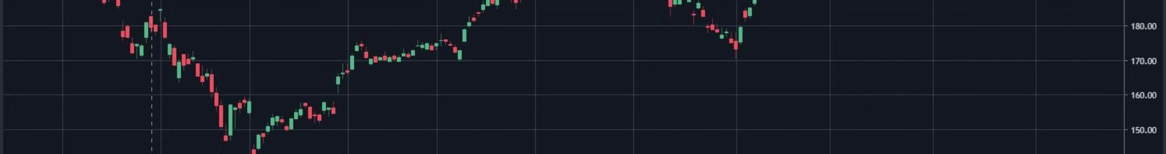
Investment Approach
Value
The strategy focuses on entering the market at low points, when the indices are in the "oversold" zone and the market sentiment is dominated by fear or extreme fear. This "value" approach aims to capitalize on the potential for significant upside as the market rebounds.
Periodic Rebalancing
The portfolio is periodically rebalanced based on the investor's risk appetite, as determined by a proprietary risk score analyzer. This ensures that the asset allocation remains aligned with the investor's risk tolerance and investment objectives.
1
2
3
Momentum
The strategy also seeks to invest in the relatively faster-moving indices, such as the Midcap 150 and Smallcap 250, to capture the momentum-driven gains. This approach complements the value-based entry points to create a well-rounded investment strategy.

Slide 6

Risk Management
1
Exit Strategy
2
Emergency Fund
3
Gold ETF
The strategy employs a disciplined exit strategy, selling the indices when the market sentiment is in the "Greedy" or "Extreme Greedy" zone, the RSI is above 75, and the P/E ratio is in the overbought zone.
The portfolio includes an allocation to a safe, liquid "Emergency Fund" to provide a buffer against market downturns and ensure the stability of the overall investment strategy.
The strategy also incorporates a Gold ETF allocation, which serves as a hedge against market volatility and provides an additional layer of diversification to the portfolio.

Slide 7
Deployment Phases
Initial Load
Daily Monitoring
The initial investment phase involves finding the most suitable entry point for the indices, when the market sentiment is in the "Fear" or "Extreme Fear" zone and the indices are in the "oversold" zone.
A daily job is responsible for predicting the lowest and highest points in the upcoming week for each index, allowing the strategy to capitalize on these entry and exit opportunities.
Portfolio Rebalancing
Partial Withdrawals
The portfolio is rebalanced on a monthly basis, with the strategy predicting the lowest and highest points in the upcoming quarter and executing trades accordingly.
The strategy also incorporates a systematic withdrawal plan (SWP) to allow investors to periodically withdraw funds from the portfolio, while maintaining the overall asset allocation.

Slide 8



Forecasting Methodology
ARIMA
LSTM
Macroeconomic Factors
The strategy utilizes ARIMA (Autoregressive Integrated Moving Average) models to predict the future closing prices of the indices based on historical data and relevant macroeconomic factors.
Additionally, the strategy employs LSTM (Long Short-Term Memory) neural networks to capture complex, non-linear patterns in the data and improve the accuracy of the forecasts.
The forecasting models incorporate a wide range of macroeconomic data, including global market indices, commodity prices, and economic indicators, to provide a comprehensive view of the market dynamics.

Slide 9
Market Mood Index (MMI)
Buy Zone
Sell Zone
1. Index pe is in over-sold zone
2. market mood index is in fear/extreme-fear zone
3. RSI of the index is below 40
1. Index pe is in over-bought zone
2. market mood index is in greedy/extreme-greedy zone
3. RSI of the index is above 75

Slide 10
Jobs
Monthly Job
Predict the Lowest and highest [i.e. point of entry and exit as per above logic] in forthcoming quarter for all the 3 indices
risk score analyzer
The function RiskScoreMixFunc(tot-risk-score) using standard deviation[=risk factor] of all the 5 indices returns ratio of N50, SML, Mid, Gold, Emergency Fund (Safest Debt/liquid fund) in mixture to achieve the given risk-score
Daily job
Predict the Lowest and highest [i.e. point of entry and exit as per above logic] in forthcoming week for all the 3 indices. If today is the lowest point in the week for an index, open position allocating %age of capital for that index as calculated by the risk score analyzer

Slide 11
Jobs continued ..
Capital movement job [Take action at real time pricing]
Enter(BUY): If today is the actual lowest point in the week for an index as predicted by job:1 and 2, and market is in BUY zone, then buy the yet to be allocated %age of capital for that index as calculated by the risk score analyzer by selling that amount of GOLD/Emergency Fund.
[Bear Market] : If that position is already achieved, while market is in buy zone, then follow a rule of buying the index: BUY of 10% GOLD + Emergency Fund price equivalent for every 2% fall of the index to tackle war or covid like exceptional situation as per the rule for selling of reserve to buy indices until 80% reserve is exhausted.
Exit(Sell): If today is the actual highest point in the quarter for an index as predicted by job:1 and 2 and the market is in SELL zone, SELL the index up to the yet to be allocated %age of capital for that index as calculated by the risk score analyzer by buying that amount of GOLD/Emergency Fund.
[Bull Market] : If that position is already achieved in SELL zone, then follow a rule of selling the index: sell the index of amount equivalent to 5% of should be allocated for reserve, for every 2% rise of the index 200% of the reserve accumulated.

Slide 12
Progress..
Done
Todo
Data Analysis – 100% complete
nifty 50 price pred – 100% complete
Mid cap 150 price pred – 100% complete
small cap 250 price pred – 100% complete
Risk score analyzer – 80% complete
Risk score analyzer [20%]
MMI Job
Core logic
workflow wrapper

Slide 13




Advantages of the Strategy
Outperformance
The strategy aims to capitalize on the historical outperformance of value and momentum investing in the Indian stock market, potentially delivering superior returns compared to traditional index funds.
Risk Management
The dynamic asset allocation and risk-based rebalancing approach help to manage the overall portfolio risk, providing a more stable investment experience for the investor.
Diversification
The inclusion of the Gold ETF and the Emergency Fund adds an additional layer of diversification to the portfolio, reducing the overall volatility and providing a buffer against market downturns.

Slide 14

Conclusion
The Enhanced Value and Momentum Index is a comprehensive investment strategy that aims to deliver superior returns by leveraging the power of value and momentum investing in the Indian stock market. Through a combination of data-driven forecasting, dynamic asset allocation, and disciplined risk management, this strategy seeks to provide investors with a unique and potentially rewarding investment opportunity.

